Slide 1




E-COMMERCE CUSTOMER ANALYTICS
Presented by Priyadarshini S
Corporate Trainer

Slide 2


PROBLEM STATEMENT
E-commerce platforms generate huge customer data (orders, visits, spending).
Small/medium businesses fail to use this data effectively.
Current focus is only on sales & revenue, not customer loyalty/retention.
Lack of insights leads to:
Missed opportunities for loyal customer targeting.
Poor churn prevention.
Inefficient inventory management.

Slide 3
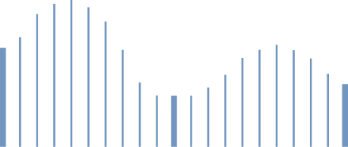

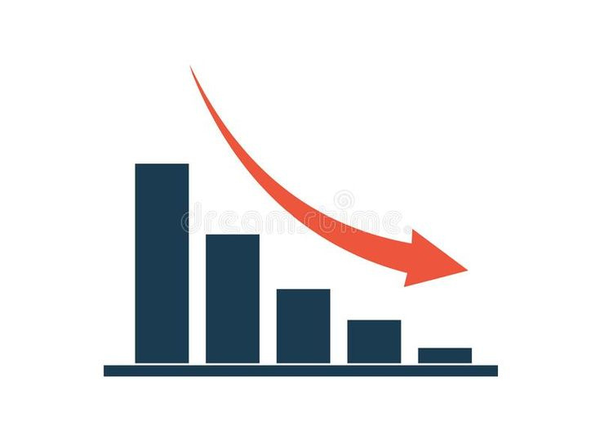
EXISTING SYSTEM
Tracks only basic sales metrics (total revenue, order count).
No customer segmentation (all treated the same).
No loyalty or churn detection.
Inventory not linked with customer demand.
Provides only static Excel reports.
Weak retention strategies → businesses don’t know why customers don’t return.

Slide 4
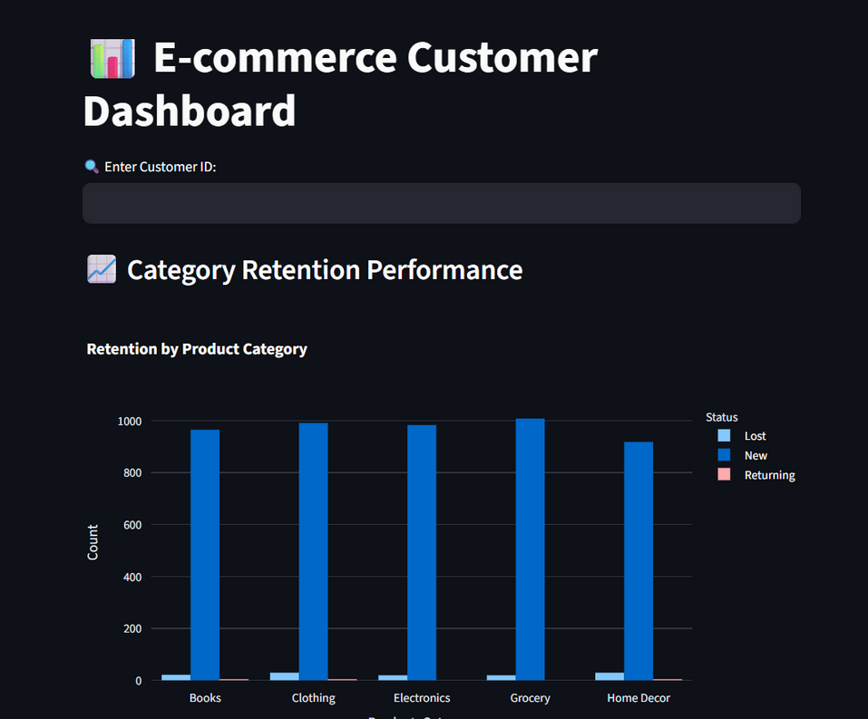
PURPOSED SYSTEM
Interactive E-Commerce Analytics Dashboard.
Features:
Customer Retention & Re-purchase
High-Value Customer Detection
Product & Category Insights
Sales & Revenue Trends
Real-time Customer Search (by ID)

Slide 5
ABSTRACT
An end-to-end E-Commerce Customer Analytics system that cleans raw retail data in Jupyter, exports curated Excel reports, and serves an interactive Streamlit dashboard where users can enter a Customer ID to see category retention performance and loyalty/high-value segmentation, plus overall business insights.

Slide 6



TECHNOLOGY USED
Python 3.x - core language
Pandas, NumPy - data cleaning, aggregation, feature engineering
Matplotlib, Seaborn - exploratory plots in notebook
ipywidgets - quick interactive filtering in notebook
OpenPyXL - read/write Excel (.xlsx)
Plotly - interactive charts in the dashboard
Streamlit - web UI dashboard with user input (Customer ID)
VS Code + Jupyter Notebook - development & analysis environment

Slide 7
METHODOLOGY
1. Data Ingestion & Preprocessing
Import data from retail dataset.
Convert dates, remove duplicates, and clean records.
Ensure structured and reliable input for analysis.
Loaded dataset (retail_data.csv.xlsx) with 5000 rows.
2. Business KPI Monitoring
Track Total Revenue, Unique Customers, and Orders.
Provides quick performance snapshot.
Helps management understand overall business health.
3. Category & Regional Revenue Insights
Analyze revenue by Product Category.
Apply city filter for region-specific analysis.
Visualized via bar charts for decision-making.

Slide 8



METHODOLOGY
Customer Retention & Loyalty Analysis
Segment customers into New, Returning, Lost.
Build pivot tables for category vs retention view.
Identifies loyal customers and churn risk.
Spending Behavior Analytics
Use boxplots to study spending variation.
Detect average spend, outliers, and high-value customers.
Guides pricing and promotional strategies.
Automated Reporting & Export
Export results into Excel for sharing.
Store clean data and retention reports in multiple sheets.
Enables non-technical teams to access insights easily.

Slide 9
TECHNOLOGY OVERVIEW - STREAMLIT
Streamlit is an open-source Python framework used to create interactive web applications and dashboards for data science and machine learning projects.
E-commerce Analytics Dashboard where:
Users can enter Customer ID and instantly see their retention performance and loyalty segmentation.
Managers can view Category-wise revenue, KPIs, and spending behavior interactively.
Reports and insights are more visual, dynamic, and business-friendly compared to static Excel sheets.

Slide 10
TECHNOLOGY OVERVIEW - STREAMLIT
Dashboard Title & Input Setup → Define dashboard title and enable Customer ID input for personalized search.
Customer Profile Display → Show essential customer details dynamically.
KPI & Segmentation Logic → Calculate purchases, average rating, and classify into customer segments.
Behavior Visualization → Generate interactive charts (timeline, ratings, purchases, retention).
Retention Analysis → Compare loyalty levels across product categories.
Error Handling → Add warnings for invalid IDs to ensure smooth user interaction.

Slide 11
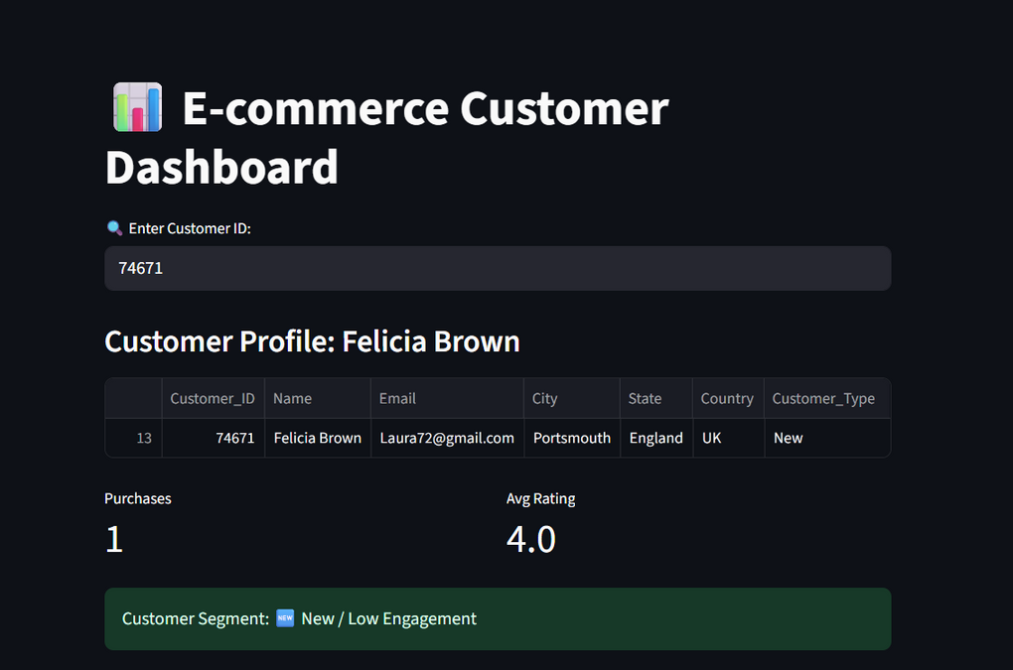
OUTPUT

Slide 12
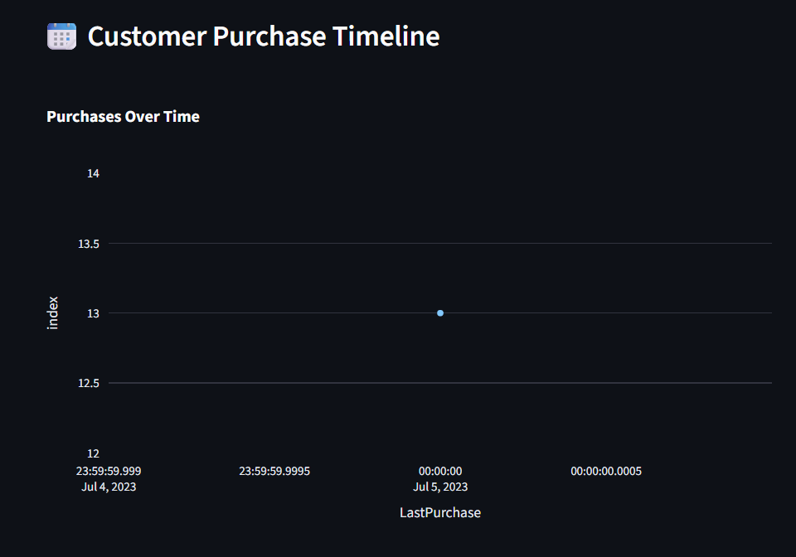
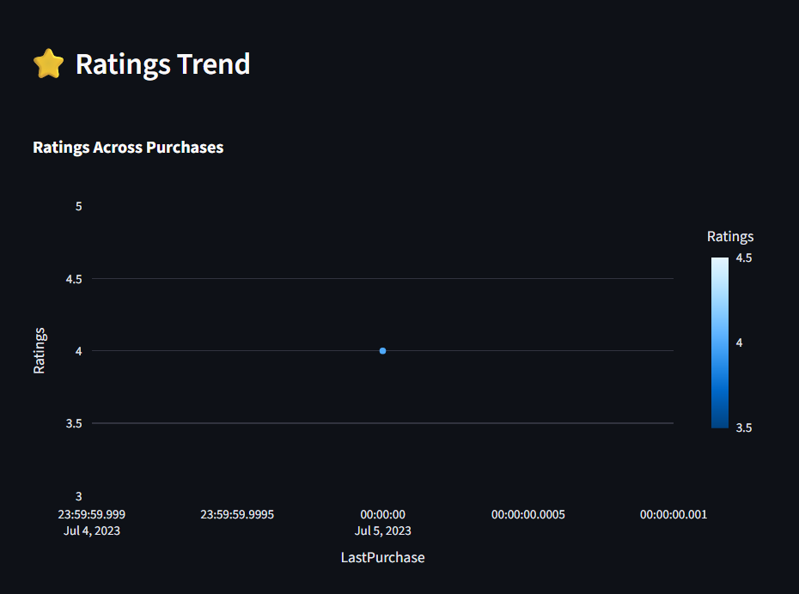
OUTPUT

Slide 13
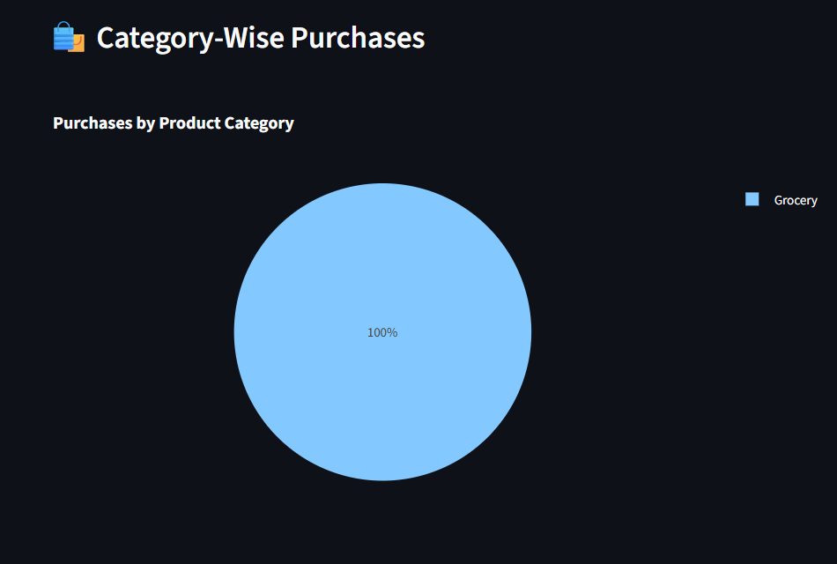
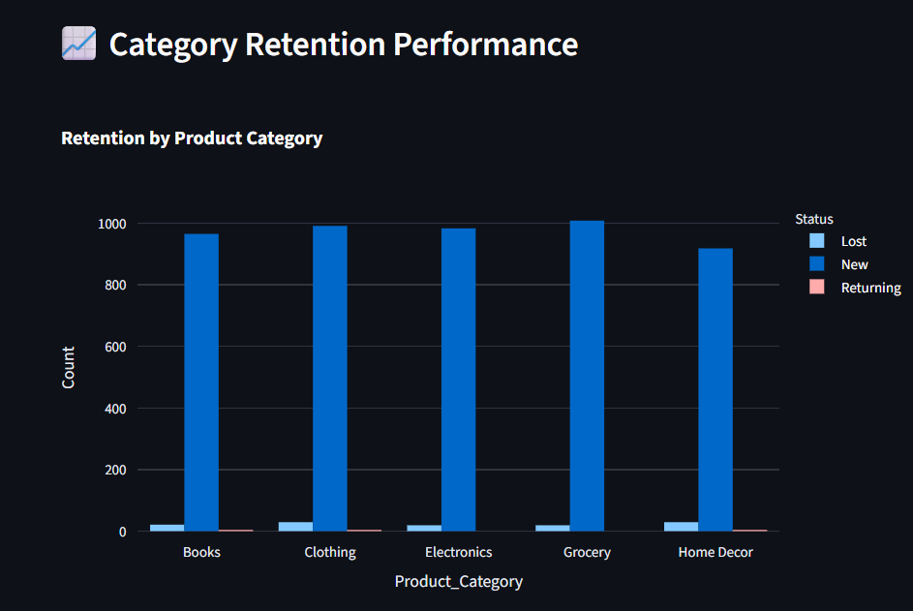
OUTPUT

Slide 14
FUTURE ENHANCEMENT
Advanced Customer Segmentation
Implement RFM (Recency, Frequency, Monetary) analysis
Use Machine Learning models for predicting churn and loyalty
Integration with Real Data Sources
Connect to live databases (MySQL, PostgreSQL, MongoDB)
Enable real-time data streaming from e-commerce platforms
Automation & Alerts
Automated reports emailed to stakeholders
Alerts for churn risk customers or top spenders

Slide 15




GITHUB LINK
Add a little bit of body text

Slide 16
THANK YOU!

